Slide 1
Load Flexibility
Preliminary Ice Storage Results for Metric Discussion
Ryan Meyer and Karl Heine
July ##, 2019

Slide 2
Content Overview
Model Descriptions
Annual Metrics Comparison
Monthly Peak Demand Comparison
Average Daily Demand Profile Comparison
Load Duration Curve Comparison

Slide 3
Model Descriptions
DOE Prototype Secondary School
90.1-2010
Climate Zone 2A
Houston, TX
Cooling Plant
Baseline
Air-cooled chiller at 90.1-2010 minimum performance
Ice Storage Models
Air-cooled chiller at 70% of Baseline model capacity
Discharge Window – 8 am to 8 pm Weekdays only
Charging Window – 11 pm to 6 am
Two Configurations
Chiller placed upstream of ice storage tank
Ice storage tank placed upstream of chiller

Slide 4
Annual Metrics Comparison
Model | EUI |  | Facility Annual MWh |  | Cooling Annual MWh
Baseline | 68.3 | - | 3,091 | - | 1,192 | -
Chiller Upstream | 66.0 | -3% | 2,949 | -5% | 1,064 | -11%
Ice Tank Upstream | 66.7 | -2% | 2,992 | -3% | 1,108 | -7%

Slide 5
Annual Metrics Comparison
Model | Facility Peak kW |  | Cooling Peak kW |  | Average Chiller COP | Runtime Hours
Baseline | 991.5 | - | 576.7 | - | 2.55 | 5947
Chiller Upstream | 834.4 | -16% | 419.7 | -27% | 3.07 | 5764
Ice Tank Upstream | 793.4 | -20% | 371.8 | -36% | 2.94 | 6237

Slide 6
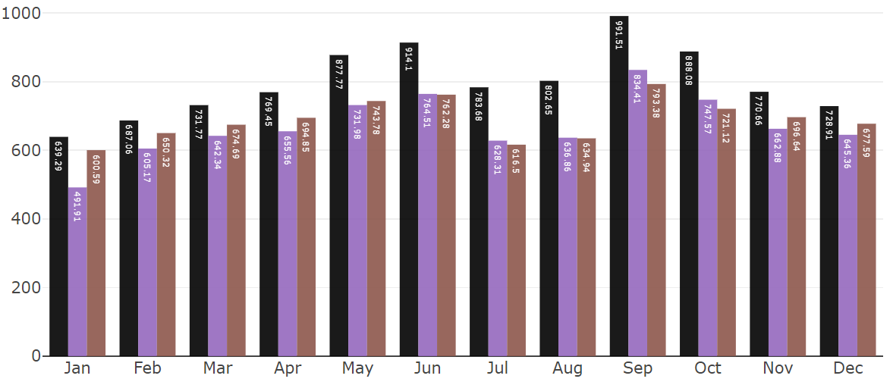
Monthly Peak Demand Comparison
kW
Baseline (No Ice) Chiller Upstream Ice Upstream

Slide 7
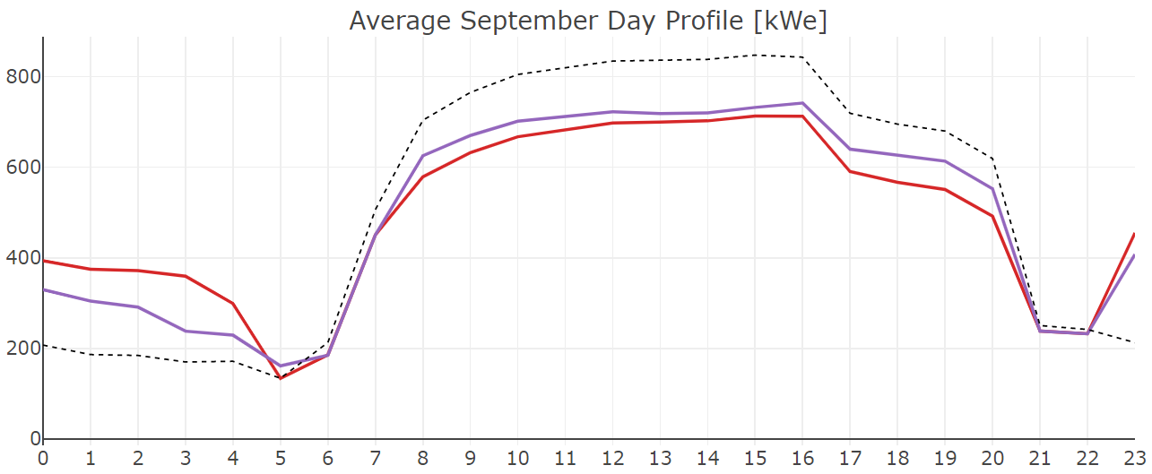
Average Daily Demand Profile Comparison
kW
Baseline (No Ice) Chiller Upstream Ice Upstream

Slide 8
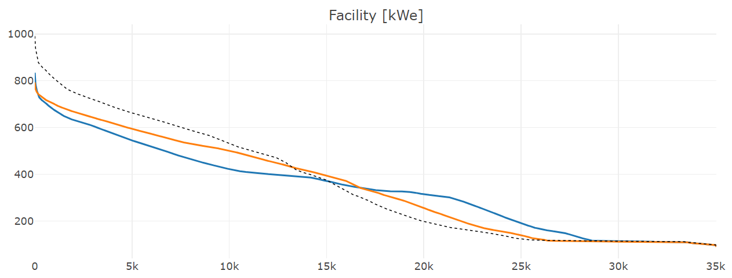
Load Duration Curve Comparison
kW
Baseline (No Ice) Chiller Upstream Ice Upstream

Slide 9
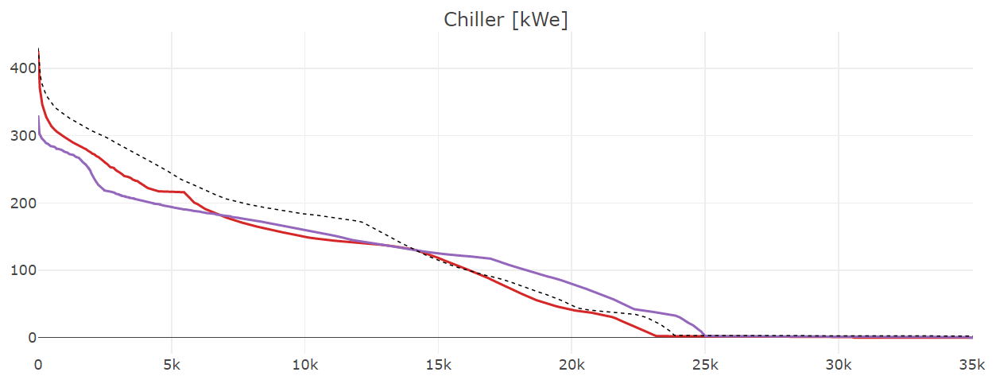
Load Duration Curve Comparison
kW
Baseline (No Ice) Chiller Upstream Ice Upstream

